Slide 1
Performance Management Framework
Mental Health Service Providers
February 2022

Slide 2

WA Primary Health Alliance acknowledges and pays respect to the Traditional Owners and Elders of this country and recognises the significant importance of their cultural heritage, values and beliefs and how these contribute to the positive health and wellbeing of the whole community.
Koorn Koorl Danjoo (Coming Together)
John Walley 2018

Slide 3
Agenda
Item | Agenda | Lead
1 | Welcome and acknowledgement of country | MC
2 | Purpose of today’s session | MC
3 | PMF overview Timeframes for implementation MH Indicators | MC / MH
4 | Additional Changes as part of Contract Variations | MH
5 | Service Provider Portal development | MC
6 | Questions | ALL
7 | Thank you & Close
Presenters
Mark Cockayne
General Manager Commissioned Services
Matt Hunt
Senior Contracts Manager
Commissioned Services

Slide 4
Introduction
WA Primary Health Alliance aims to improve the health outcomes of the communities we serve across Western Australia.
One of the ways we do this is by funding local primary health care services based on community needs.
Our Commissioned Service Providers are an essential part of the local health system and deliver a range of treatment and screening services.
WAPHA’s new Performance Management Framework (PMF) will support the achievement of WAPHA’s strategic vision and commitment to building a strong and sustainable primary health care system; and delivering on our strategic priority of bringing a more structured and data driven approach to the management of performance and quality improvement.

Slide 5
Purpose
Why do we need to put a Performance Management Framework in place?
Responds to provider feedback:
“we need to know the ground rules” “what do you do with the data we give you” “how do you evaluate our performance” “how do we know if we’re doing well”
Articulates WAPHAs performance management approach for Commissioned Service Providers
Aims to give Commissioned Service Providers clarity on how we will:
  Set performance expectations
  Measure, monitor and manage performance, and
  Engage with providers in relation to performance management
  There is a dual responsibility as key component of this relationship

Slide 6
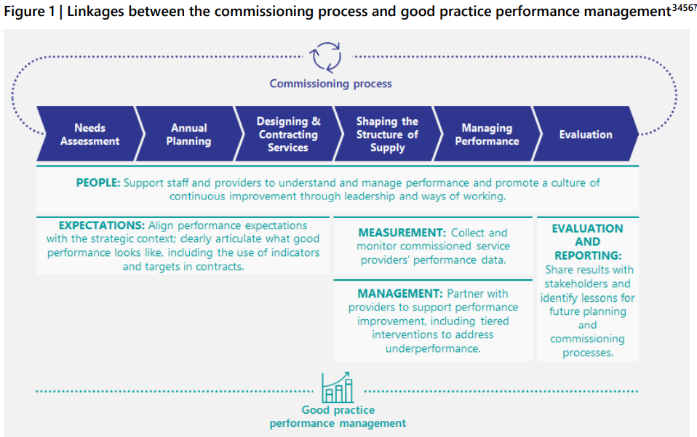
What is Performance Management
Continuous process of improving performance by setting expectations, and regularly monitoring, reviewing, and measuring progress against these expectations

Slide 7
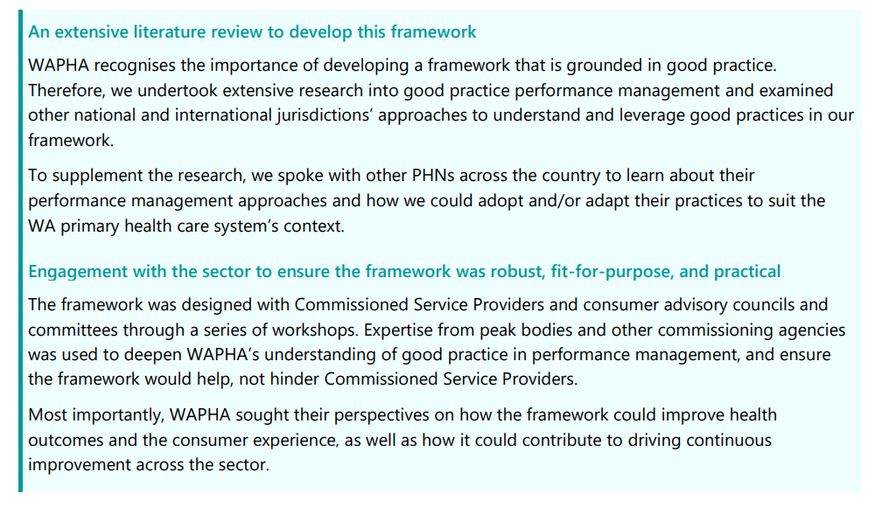
Process of Development

Slide 8
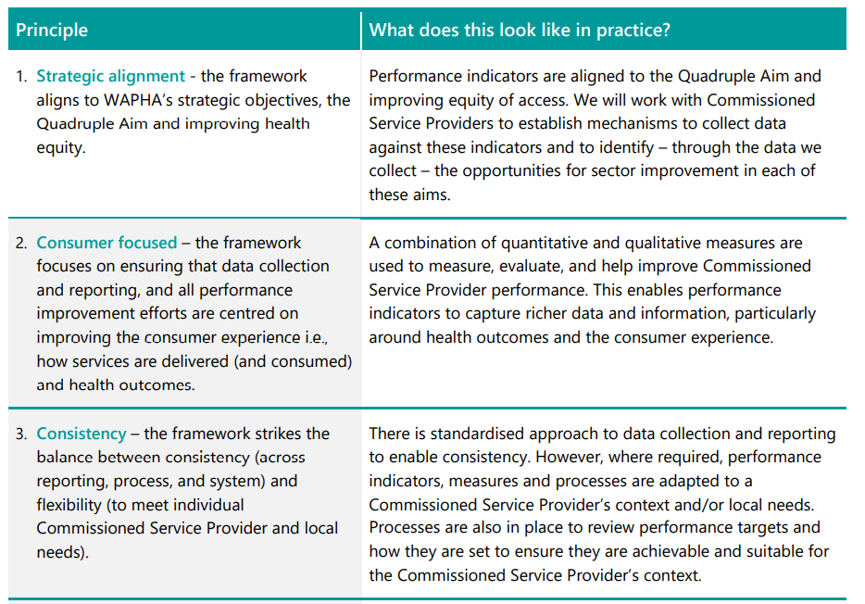
Principles
Developed and tested with the sector to guide Framework development

Slide 9
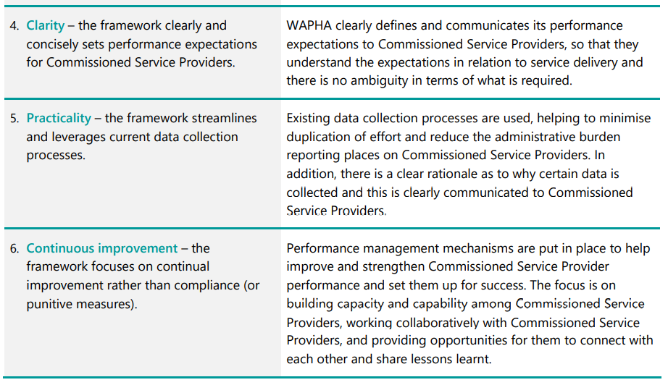
Principles
Developed and tested with the sector to guide Framework development

Slide 10
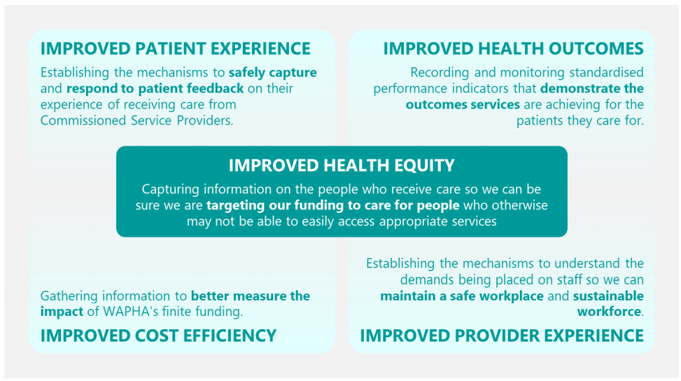
Strategic Environment
Framework aligns with the national, state and local contexts, including
  PQF Indicators (PHNs required to report to Commonwealth)
  Existing state government performance reporting
Framework aligns to the Quadruple Aim

Slide 11
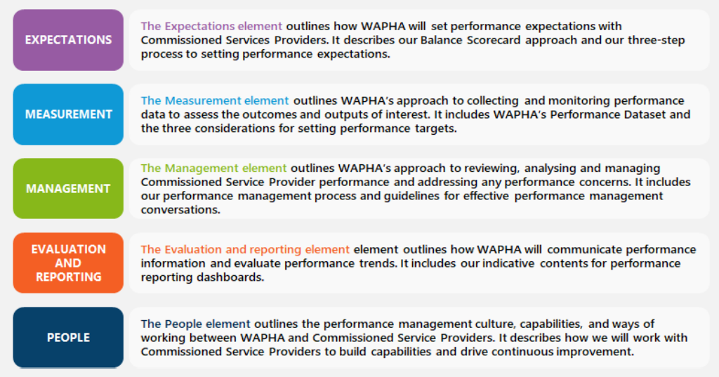

Performance Management Framework

Slide 12
Applying the Framework
Part B of the document outlines WAPHAs approach to applying the Framework
Chapters:
  3. Expectations
  4. Measurement
  5. Management
  6. Evaluation and Reporting
  7. People
Each chapter outlines how the elements should be applied in practice, including:
  A definition of each element
  The processes and approaches WAPHA will adopt to measure, monitor, manage and communicate provider performance
  High-level guidance for WAPHA and Commissioned Service Providers on how to put the Framework’s elements into practice

Slide 13
Mental Health Indicators In Contract Variations
Appropriate targets will be set at a contractual level (i.e. as appropriate for each contract) and confirmed at a later date.
Improved Health Equity | Suggested Target - TBC as appropriate for each contract
% of low socio-economic clients | >50% clients residing in SEIFA deciles 1-3
% ATSI clients | >x% clients being ATSI status (set per contract)
% services delivered to ATSI clients being culturally appropriate | 100% ATSI clients contact culturally appropriate.
Improved patient experience
% clients felt safe using this service | >70% clients reporting usually or always
% clients had access to this service when they needed it | >70% clients reporting usually or always
% clients reporting that their individuality and values were respected | >70% clients reporting usually or always
% clients reporting positive overall experience in the last 3 months | >70% clients reporting good, very good or excellent
Improved health outcomes
% of clients who demonstrate clinical improvement | % clients clinically improved: >65% Severe/Very Severe, >50% Moderate, 35% Mild, >15% Sub-Diagnostic
Outcomes compliance | >70% matched pairs on conclusion of episode
% clients at risk of suicide followed up within 7 days of referral | 100% clients at risk of suicide followed up within 7 days
Improved provider experience
TBC
Improved cost effectiveness
Total number of episodes | 5% increase on prior year
Average cost per episode | On par or below prior year

Slide 14
Mental Health Indicators Implementation
February & March 2022
Contracts variations to be offered for 22-23
Consultation with Mental Health providers on agreed indicators and measures commences individually via their Contract Manager
Other program areas including AOD, Aboriginal Health, population health, chronic conditions, and aged care will progressively occur after this timeline and align with Commonwealth funding parameters

Slide 15
Other Changes in Contract Variations
The requirement for Governance Transition Report will be removed
The requirement for Transition Out Plan will be removed
The 6 and 12 month reports for those undertaking PMF reporting will be removed
Six month financial reporting will only be required on request
The requirement to submit organisations consolidated financial report (whole of organisation financial) will be removed
The inclusion of the requirement to have or maintain relevant Mental Health accreditation by 30 June 2023
Endeavouring to change from 4 milestone payments to 3 milestone payments (subject to Commonwealth payment schedule)

Slide 16
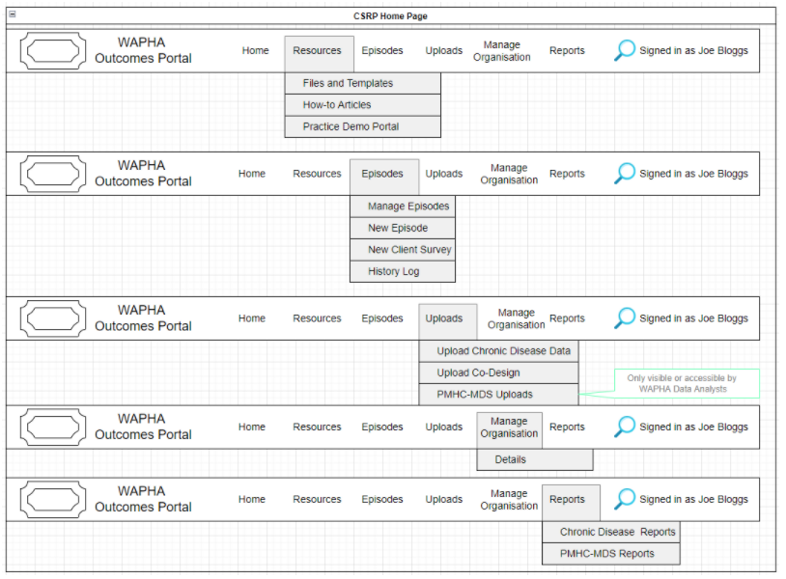
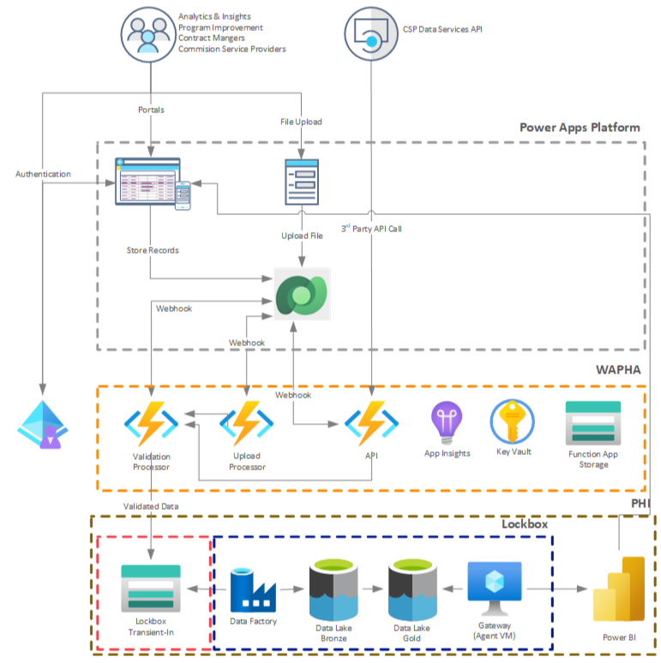
Bigger Picture – Service Provider Portal

Slide 17
Questions

Slide 18
Thank you

